Slide 1
Upcoming assignments
Friday Feb 22
Exam 2
March 1
TP2 Questionnaire draft
March 8
Quiz 3

Slide 2
Exam 2
Will be posted Monday Feb 18th

Slide 3
Student question on gun laws, more evidence on what works?

Slide 4
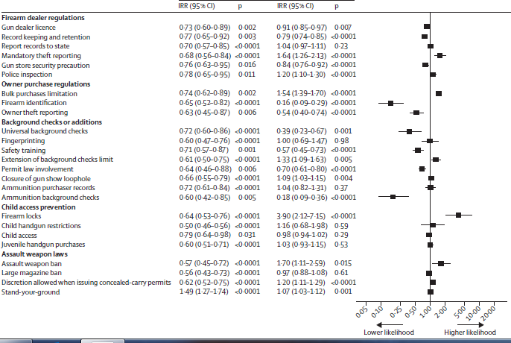
Gun Laws. An Evidence Based Approach. Kalesan et al. 2016 Lancet
4

Slide 5
95%CI “Borderline” Interpretation
95%CIs
“Borderline” significant if one bound of 95%CI is very close (equal or below) the null value.
Ratio measure 95%CI (0.97, 2.3)

Slide 6
Study Designs: Case Control
EPID600
Prof. Yeatts
February 12, 2019

Slide 7
Course Objectives
Explain the importance of epidemiology for informing scientific, ethical, economic and political discussion of health issues.
Describe a public health problem in terms of person, place, and time.
Apply the basic terminology and definitions of epidemiology.
Calculate basic epidemiology measures.
Identify key sources of data for epidemiologic purposes.
Evaluate the strengths and limitations of epidemiologic reports.
Comprehend basic ethical and legal principles pertaining to the collection, maintenance, use and dissemination of epidemiologic data.
Draw appropriate inferences from epidemiologic data.
Identify the principles and limitations of public health screening programs.
Communicate epidemiologic information to lay and professional audiences.
Apply concepts, methods, and tools of public health data collection, analysis and interpretation, and the evidence-based reasoning and informatics approaches that are essential to public health practice.

Slide 8
Class objectives
•List the characteristics of case control studies.
• Differentiate between case control studies and cohort studies.
•Identify the advantages and disadvantages of case control studies.
•Explain, calculate, and interpret odds ratios.
•Explain the relation of controls in a case-control study to the study base (source population) for the cases.
•Distinguish between hospital-based and population-based controls in a case control study, and identify their advantages
• Explain why matching is used in case control studies

Slide 9
How do you identify the study design in a published study?
Ask these 2 questions:
When were the exposure and outcome measured? (from investigator perspective)
Exposure before outcome?
Outcome before exposure?
Exposure and outcome at same time?
What was the unit of analysis?
Group or individual?

Slide 10
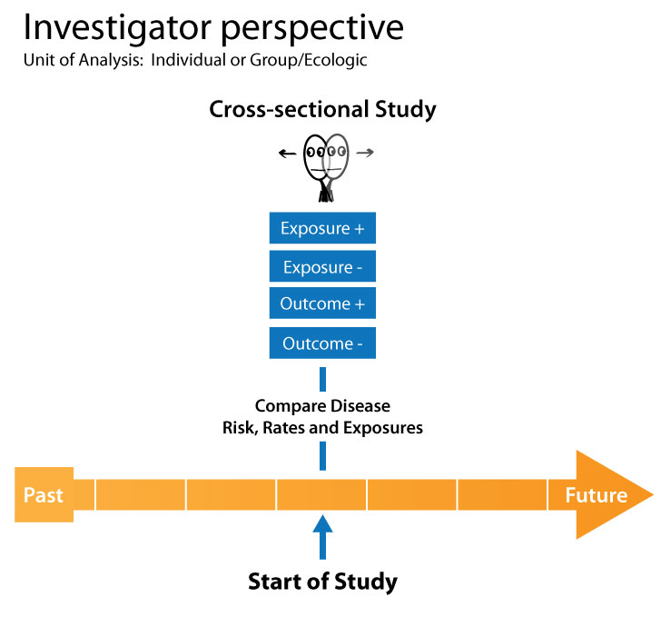

Slide 11
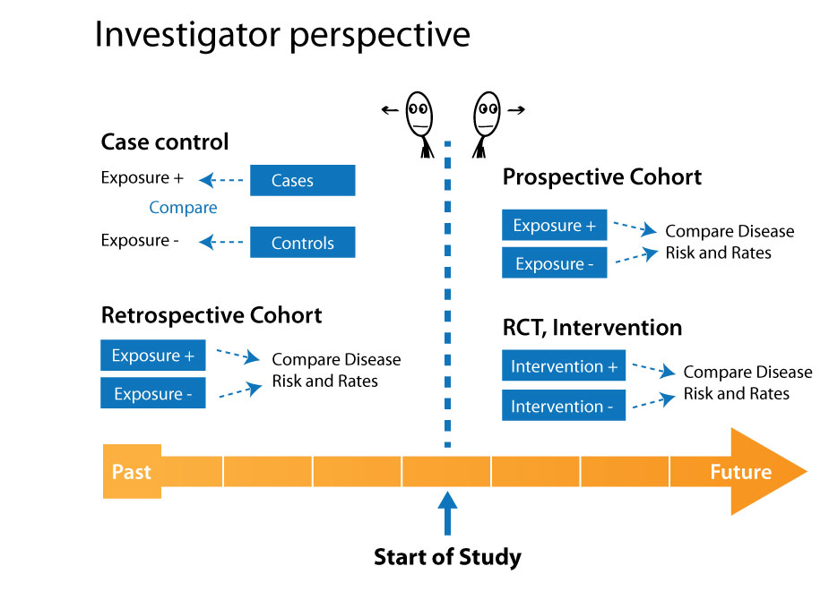

Slide 12



Cases
Controls
EXPOSURE
EXPOSURE
1970
1980
1990
PRESENT
1970
1980
1990
PRESENT

Slide 13
Caveat on term “control group”
In a randomized control trial, a “control group” means those that are not randomized to the exposure of interest.
In a cohort study, the control group refers to those in the unexposed group.
In case control studies, a “control group” means a group of individuals selected WITHOUT THE DISEASE- who, if they had developed the disease would be selected a case.

Slide 14
Case Series/Case Reports
A study design that includes only cases, no control group.
Common in medical literature
Can not make conclusions about exposure outcome relationship.
Hypothesis generating

Slide 15

Case Series
A series of cases

Slide 16
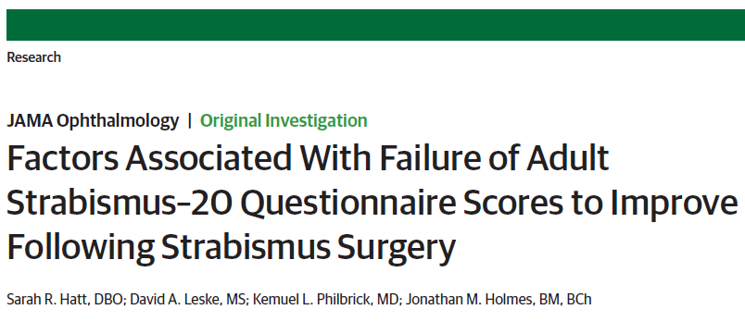
Case Series/Case Reports
JAMA Ophthalmol. 2018 Jan 1;136(1):46-52. doi: 10.1001/jamaophthalmol.2017.5088.
Design, Setting, and Participants:
Prospective observational case series at the Mayo Clinic, Rochester, Minnesota, comprising 276 adults, between July 2012 and August 2016.
Results:
Of the 276 participants, the median age was 57 years (range, 18-91 years), 153 were women (55%), and 266 were white (96%). Failure to improve was associated with worse diplopia postoperatively on the self-perception (adjusted risk ratio [RR], 1.01; 95% CI, 1.00-1.02), reading function (adjusted RR, 1.02; 95% CI, 1.01-1.03), and general function domains (adjusted RR, 1.02; 95% CI, 1.01-1.03).

Slide 17
Case Series Examples
Pathology of congenital Zika syndrome in Brazil: a case series.
Martines RB et al. Lancet. 2016 Aug 27;388(10047):898-904. doi: 10.1016/S0140-6736(16)30883-2.
Congenital Zika virus syndrome in Brazil: a case series of the first 1501 livebirths with complete investigation.
França GV, et al. Lancet. 2016 Aug 27;388(10047):891-7. doi: 10.1016/S0140-6736(16)30902-3.

Slide 18
Case Control Studies
efficient method to study rare diseases
Per 100,000 individuals Per 100,000 individuals
Pancreatic cancer example
http://seer.cancer.gov/statfacts/html/pancreas.html
Notes:
Pancreatic cancer example
http://seer.cancer.gov/statfacts/html/pancreas.html
The number of new cases of pancreatic cancer was 12.4 per 100,000 men and women per year. The number of deaths was 10.9 per 100,000 men and women per year.
45,702 people living with pancreatic cancer in 2012
312 million US population in 2012
This is 0.000146 of the US population, or 0.0146%, or 14 per 100,000 population

Slide 19

Efficiency Example-
Hypothetical
Teachers Cohort Study
Cohort:
89,949 women age 50-75
Study Hypothesis:
Pesticide exposure related changes in microbiome increases risk of Parkinson’s disease
Characteristics:
Avid gardeners; use pesticides
Outcome of interest:
Parkinson’s disease
[
]
1,439

Slide 20
Efficiency Example-Pesticide Exposure Assessment in Cohort Study
Total Number in cohort=89,949
Cost of pesticide related microbiome assay=$100
Total cost of exposure analysis=$8,994,900

Slide 21

Efficiency Example- Case-Control Study
Parkinson’s Disease
PESTICIDE
YES
NO
High
Low
Total
360
1,079
1,439
432
2,446
2,878
Cost of pesticide blood assay=$100
Total number in study=4,317
Total=$431,700
Efficient & cost effective study design

Slide 22

Measure of Association commonly used in a Case Control Study
Odds ratio=
÷
Odds of exposure for cases
Odds of exposure for controls
An odds ratio can approximate a risk ratio
when the outcome is rare.

Slide 23
Non-Diseased
Diseased
a
b
(a+b)
E
c
d
(c+d)
E
Risk exp = a/(Total Exposed) = a/(a+b)
Risk unexposed = c/ (Total Unexposed) = c/(c+d)
Notes:
“we can simplify the table by using E for Exposed and E with a line above it for Non-exposed.

Slide 24
Odds Ratio
Case
Control
Odds of being
exposed in cases
(a/c)
=
a
b
(a+b)
E+
(b/d)
Odds of being
exposed in controls
E-
c
d
(c+d)
OR = (a*d)/(b*c)
(a+c)
(b+d)
N

Slide 25
Odds Ratio
D+
D-
a
a + b
a
b
a + b
E+
c
c + d
E-
c
d
c + d
The reason you can not directly calculate risks and rates from a case control study

Slide 26
Odds Ratio
D+
D-
a
b
E+
E-
c
d
The reason you can not directly calculate risks and rates from a case control study

Slide 27
Odds Ratio
D+
D-
a
a + b
a
b
a + b
E+
c
c + d
E-
c
d
c + d
you can not directly calculate risks and rates from a case control study

Slide 28
“Exposure” Odds Ratio
Case
Control
Odds of being
exposed in cases
(a/c)
=
a
b
(a+b)
E+
(b/d)
Odds of being
exposed in controls
E-
c
d
(c+d)
OR = (a*d)/(b*c)
(a+c)
(b+d)
N

Slide 29
“Disease” Odds Ratio
Case
Control
Odds of being
a case among exposed
(a/b)
=
a
b
(a+b)
E+
(c/d)
Odds of being a control among those unexposed
E-
c
d
(c+d)
OR = a/b divided by c/d
=a/b * d/c
=(a*d)/(b*c)
(a+c)
(b+d)
N

Slide 30
EO and DO end up being the same numeric quantity
Case
Control
a
b
E+
(a/c)
(a/b)
=
(b/d)
(c/d)
E-
c
d
OR = (a*d)/(b*c)
N
Bottom line-this allows you to interpret odds ratio as those who were exposed had [OR] times the odds of [outcome] compared to those who were unexposed

Slide 31
Key Steps for Case Control Study
1
Define and select cases
2
Define and select controls
3
Compare exposure prevalence

Slide 32
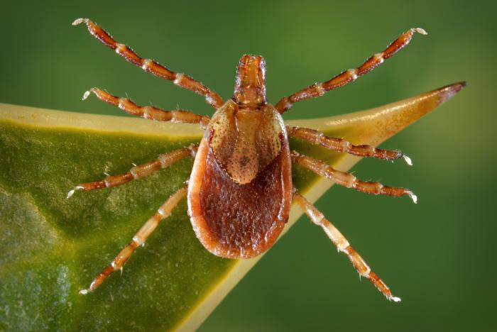
Key Steps for Case Control Study
1
Define and select cases
Determine diagnostic criteria
2
Define and select controls
3
Compare exposure prevalence

Slide 33
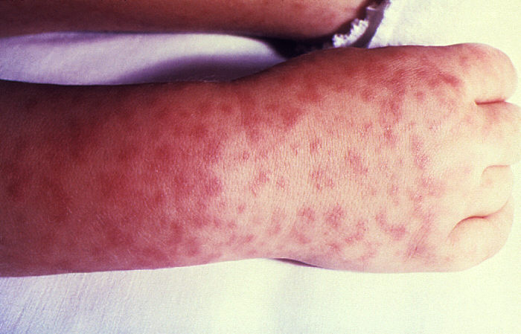
Key Steps for Case Control Study
1
Define and select cases
Determine diagnostic criteria
Incident cases are preferable
2
Define and select controls
3
Compare exposure prevalence

Slide 34
 | Ways to Select Cases | Ways to Select Controls
Population Based | X | X
Hospital Based | X | X
Convenience Controls |  | X

Slide 35
Case Selection: Population-Based
A specific geographic region is chosen as a source population with certain restriction criteria (age, SES, race, etc.)
Cases can be identified via a number of sources
Disease Registries
Surveillance databases
Hospital -Medical records
Within an existing cohort study
Managed care group

Slide 36
How do you select controls?
The goal is to ensure that controls represent the source population from which the cases arose.
If a member of the control group actually got the disease under study WOULD he/she end up as a case in your study?
Answer should be YES.

Slide 37
Control Selection: Population-Based
Best way to ensure that the distribution of exposures among controls is representative of exposure levels in the source population.
How do we find controls in the population?
Dept. of Transportation lists (driver’s license)
Government aid rosters (Medicare, Medicaid, Social Security)
Tax lists, voting lists, telephone directories
Recruitment advertising – usually with monetary incentive
Random digit dialing
What problems might you have with any of these data sources?

Slide 38
Control Selection: Population-Based
Advantages
All advantages and disadvantages of using population-based cases apply to using population-based controls.
Most importantly, you are usually more confident that your controls and cases come from the same source population.
Disadvantages
May remember exposures differently than cases (recall bias)
Population-based controls may be less likely to participate
Using population-based controls may increase $ (offering monetary compensation for participation).
Population-based control selection may miss certain strata of the population.
E.g. random digit dialing

Slide 39
Control Selection: Hospital-Based
Advantages
All advantages and disadvantages of using hospital-based cases apply to using hospital-based controls.
Most importantly, you can usually assume that whatever selection factors influenced a case’s decision to use a certain medical facility will also be operating on the controls.
Disadvantages
Difficult to define the source population for hospital-based controls.
Hospital-based controls may not be representative of the true exposure rates in the target population.

Slide 40
Nested case control studies vs. “regular” case control
Nested case control-conducted within an existing cohort.
Source population for controls is already defined.
In a regular case control, the source population is not already defined

Slide 41
Control Group 1
Key Steps for Case Control Study
1
Define and select cases
Determine diagnostic criteria
Incident cases are preferable
Control Group 2
2
Define and select controls
Multiple controls per case (statistical power)
Multiple control groups (consistency = credibility)
Control Group 3
3
Compare exposure prevalence

Slide 42
How many controls? What kind?
Should we use more than one control group (multiple TYPES of controls)?
If researchers suspect that one control group will have certain deficiencies that another does not, then by comparing cases to more than one control group, we can get a better idea of the true magnitude of the exposure’s effect.
How many controls do we enroll for each case? (matching)
Using > 1 control for each case increases the statistical power of the study (the probability that you will find an association, if one exists).
Selecting the case-to-control ratio is a balance between statistical power and precision, and cost of enrolling more persons in the study

Slide 43




Case
Control
5-year old boy
5-year old boy
10-year old girl
10-year old girl
Notes:
Rationale for matching:
Efficiency: to insure that the distribution of an external risk factor is similar between cases and controls, e.g. age and/or sex
Matching assures that the distribution of an important external risk factor is equal between cases and controls, e.g. age
Matching prevents evaluating the effect of the matching factor on disease risk

Slide 44
Control sampling from nested case control studies
Survivor Sampling-controls sampled from survivors at end of follow up time.
Base Sampling-controls sampled from population at
risk when follow up begins (case cohort)
Risk Set Sampling-controls sampled from population at risk as cases
are diagnosed, rare disease assumption not needed

Slide 45

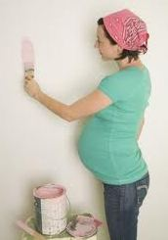

Example 1- “Expecting? let’s renovate!”
“Exposure to household painting and floor treatments, and parental occupational paint exposure and risk of childhood brain tumors: results from an Australian case–control study”

Slide 46
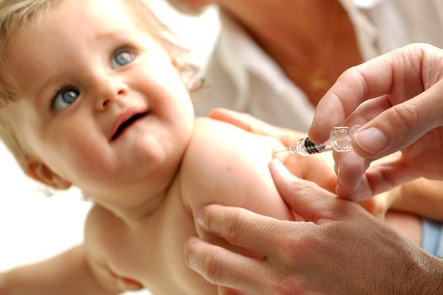
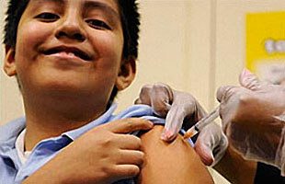
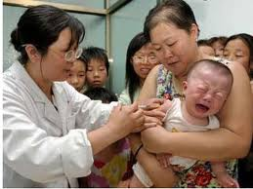
Example 2-Vaccines and Autism (covered in lab)

Slide 47
Summary: Case-Control Studies
Advantages
Good for rare outcomes
Takes less time than cohort
Use fewer resources and $
Can examine multiple exposures
Likely to be replicable in other populations
If sampled accurately, odds ratio provides estimate of risk ratio
Disadvantages
Some possible biases in selection of subjects, measurement of exposures, and analysis
No direct estimate of risk or rate ratio,
Not good for rare exposures
Sometimes time sequence between exposure and outcome is uncertain
If properly performed (such as appropriate sampling), case-control studies provide information that mirrors what could be learned from a cohort study, usually at considerably less cost and time

